Slide 1
INMOVIDU AWS CLOUD COMPUTING INDUSTRIAL TRAINING (Feb’2021-Mar’2021) MAJOR PROJECT

Slide 2
NAME: ASHI DUBEY (Rajasthan Technical University, Kota B.Tech ,Computer Science and Engineering, First Year) MENTOR: SUJAY GAONKAR

Slide 3
INTRODUCTION
The following project assists to run a Game website. Now the basic requirement to run a website is to have a web server (here; Apache). Amazon Cloud Console provides us a service called EC2(i.e. Elastic cloud compute),this is like a virtual machine wherein we can install the web server and use it smoothly ;the zip file of the game can also be stored in another cloud service called S3 which can further be downloaded on the this EC2 instance itself just like a physical machine that is used by you and me!!
Installing the web sever and downloading th s3 bucket can be done using an open source software called PuTTY.
OBJECTIVE
The objective of this project is to understand how cloud as a platform can be used to store data and to deploy an instance which can be used further for various purposes one such is launching a website. This not only saves storage in our computer but also is a cost effective and much easier procedure; thanks to cloud providers like AWS ☺

Slide 4
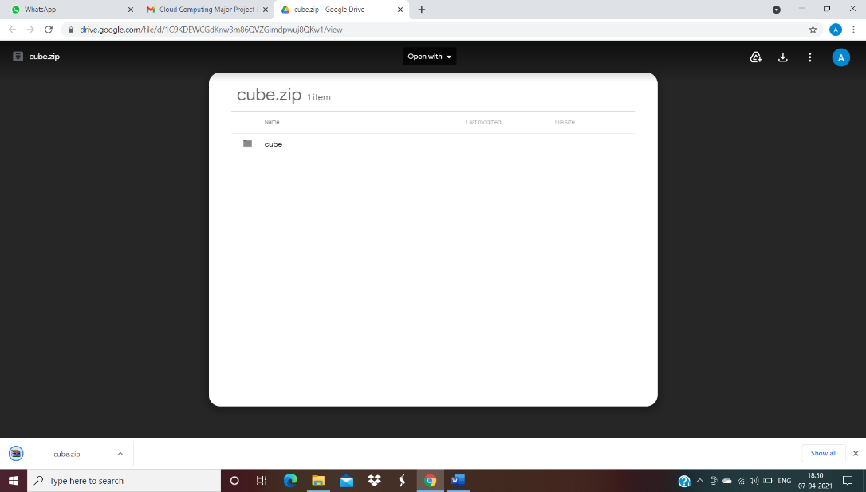
Here is the procedure I followed:-
PROCEDURE
Downloaded the zip file.

Slide 5
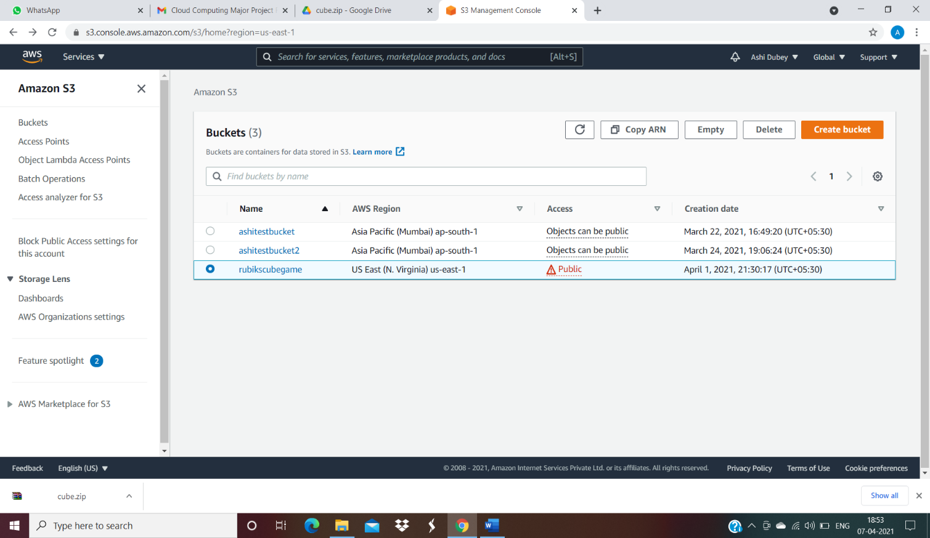
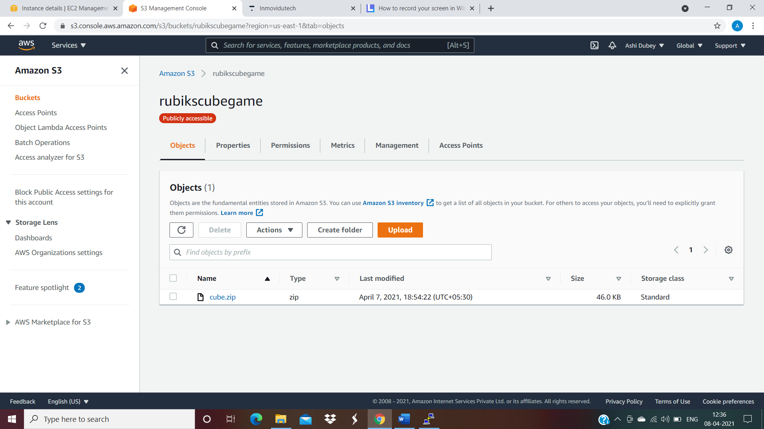
2) Created a s3 bucket and named it ‘rubikscubegame’ and deployed the zip file onto it
And made both the bucket and the file public.

Slide 6
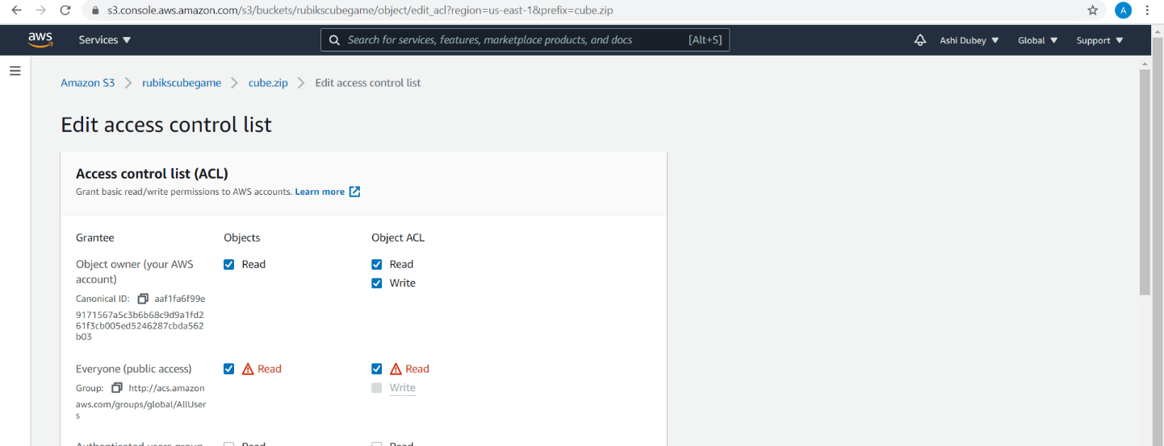
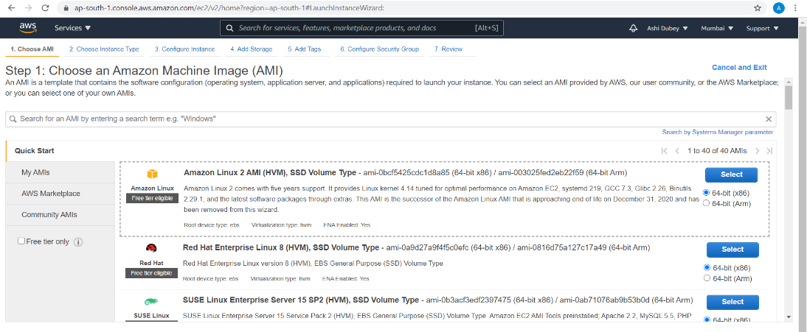
3) Created an EC2 instance named it as = rubiksGame
Also in the security groups :
Added 2 more rules- HTTP and HTTPS (Since, websites work on port 80)

Slide 7
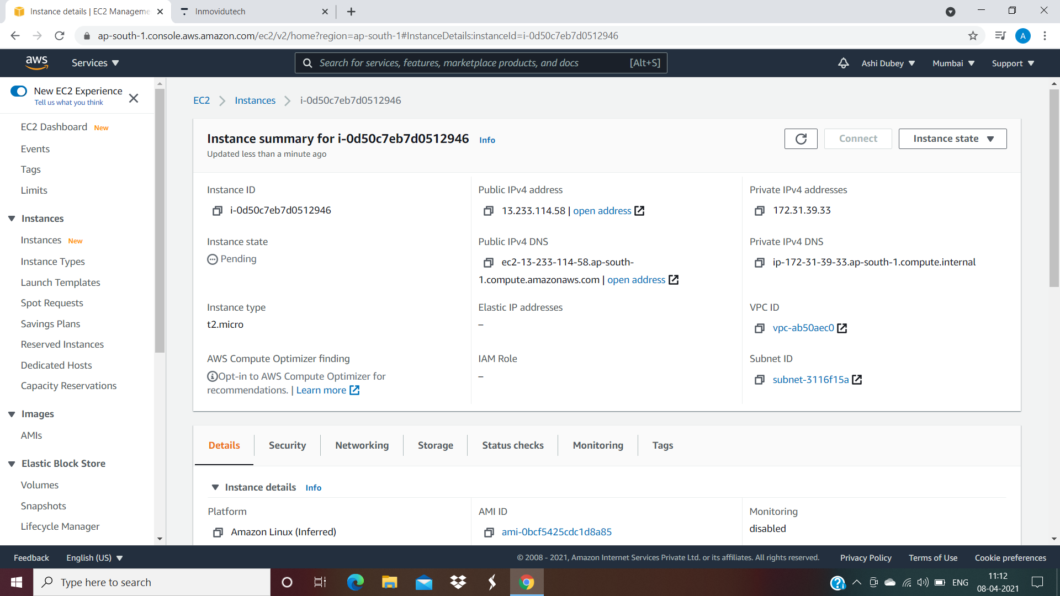
4) Used PuTTY Config to :-
Became a root user [sudo su]
Installed Apache [yum install httpd -y]
Changed the directory to [cd]->
/var/www/html
Loaded the zip file from S3 bucket [wget object url]
Unziped it [unzip fileName]

Slide 8
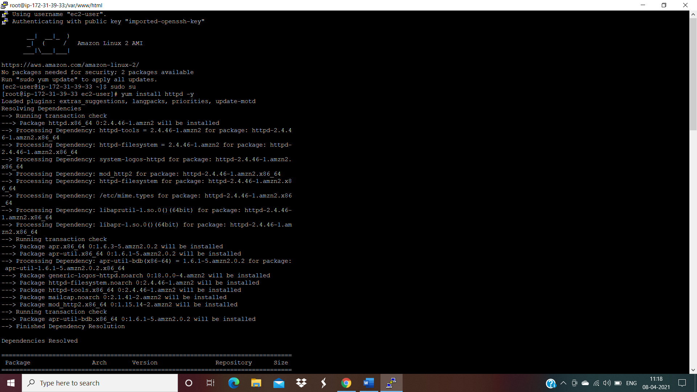
Changed directory to cube file [cd]
Copied the three files in the cube directory to the html directotry
Coped the 3 files(index.html script.js style.css) to html directory which is just prior to the cube directory.
[cp index.html script.js style.css ../.]
Changed the directory to html. [cp ..]
Then started the apache server [service httpd start]

Slide 9
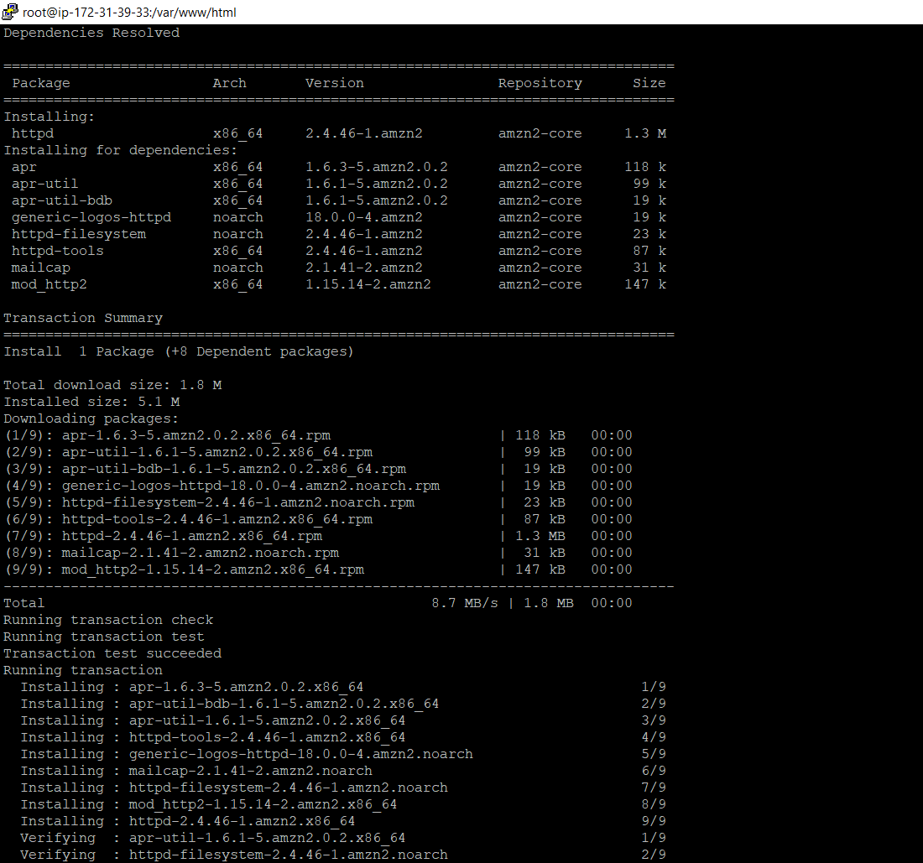
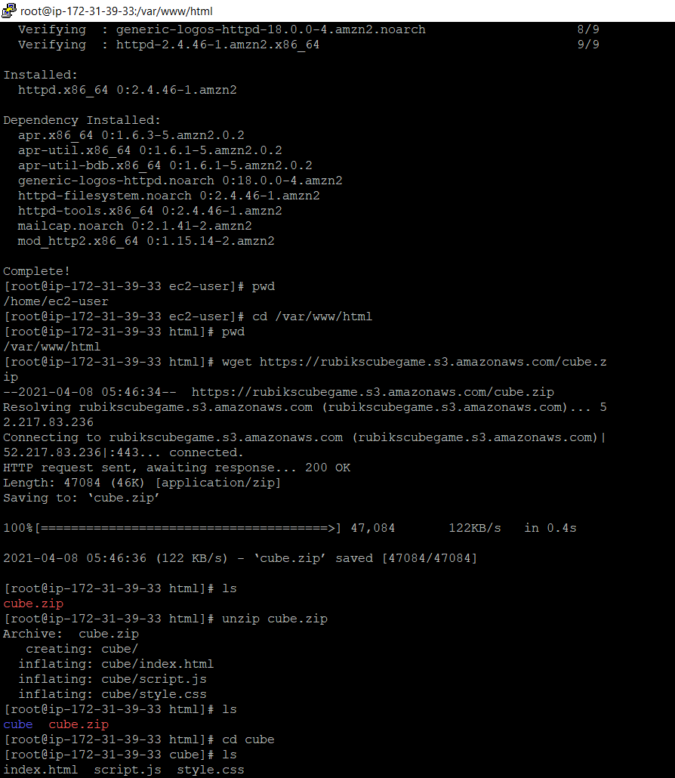
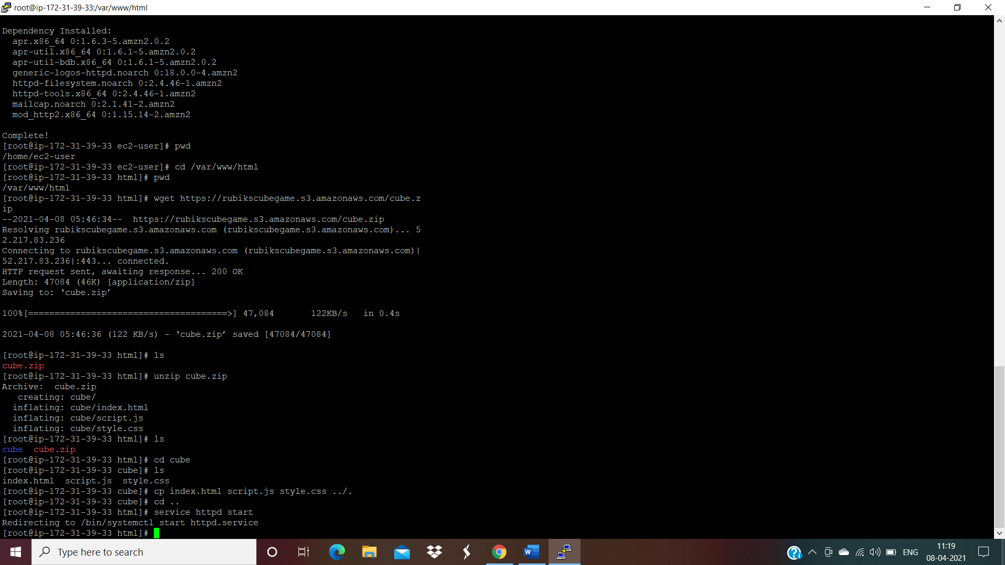

Slide 10
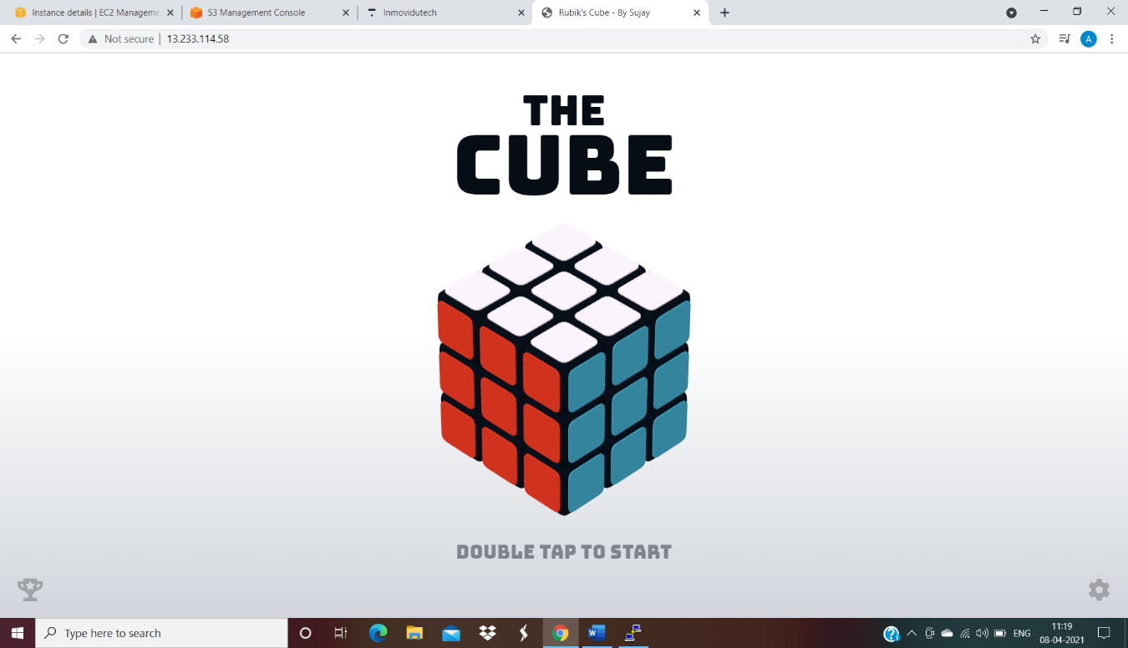
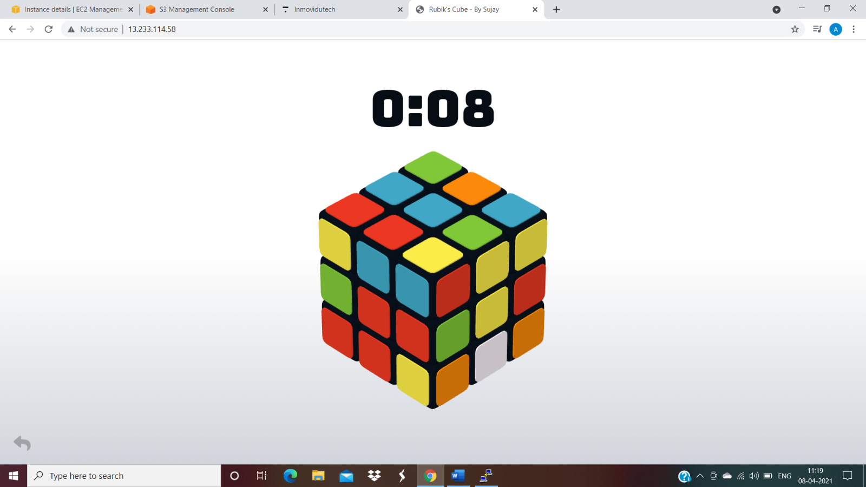
5) Then just opened a Web Browser and copied the Public IPV4 Address on it .
The RUBIKS CUBE game Launches on the screen!!
Ready to play!

Slide 11
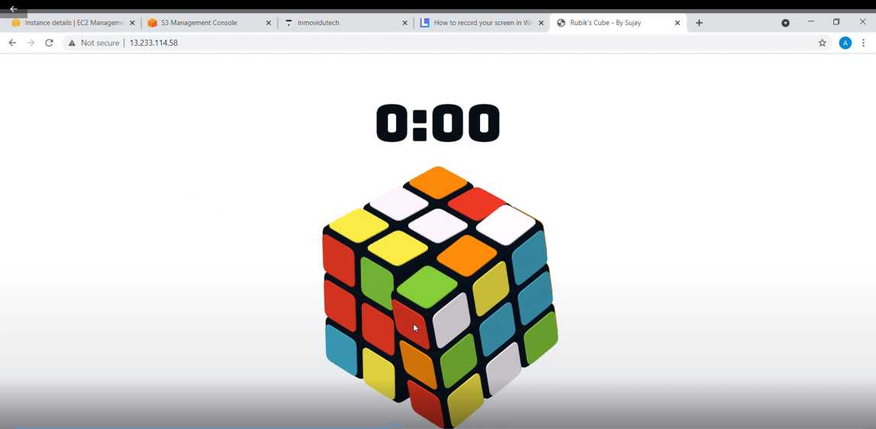
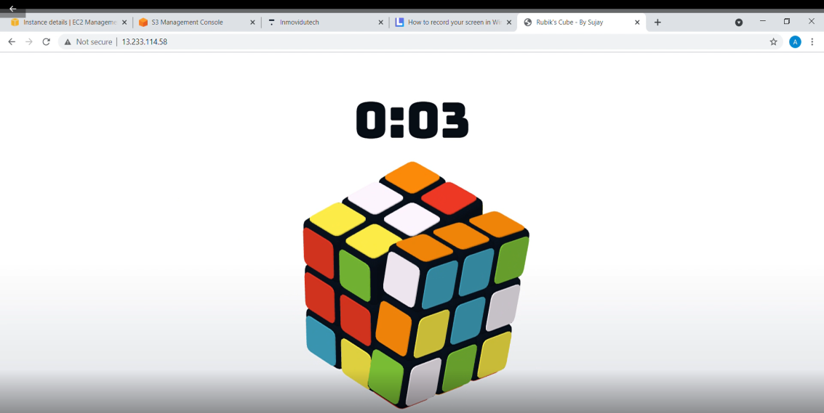
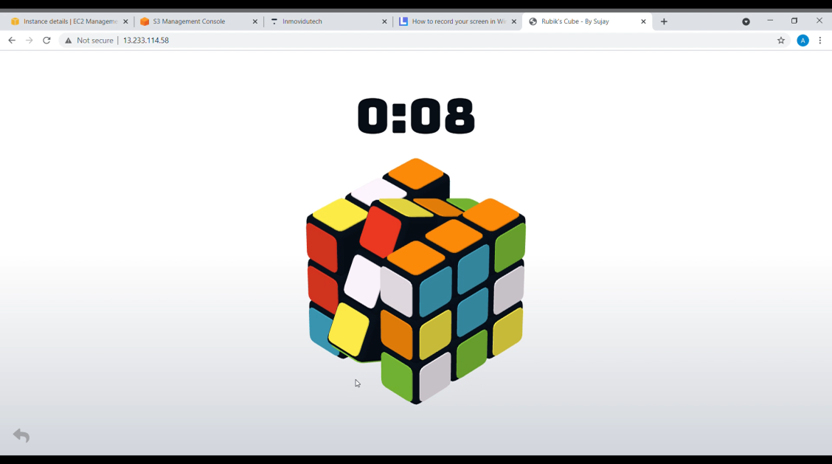
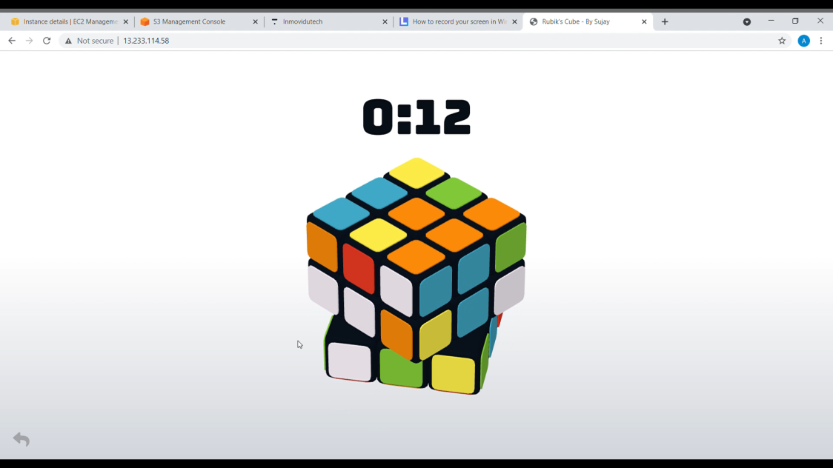
RESULT AND ACTUAL WORKING

Slide 12
THANKYOU

